Slide 1


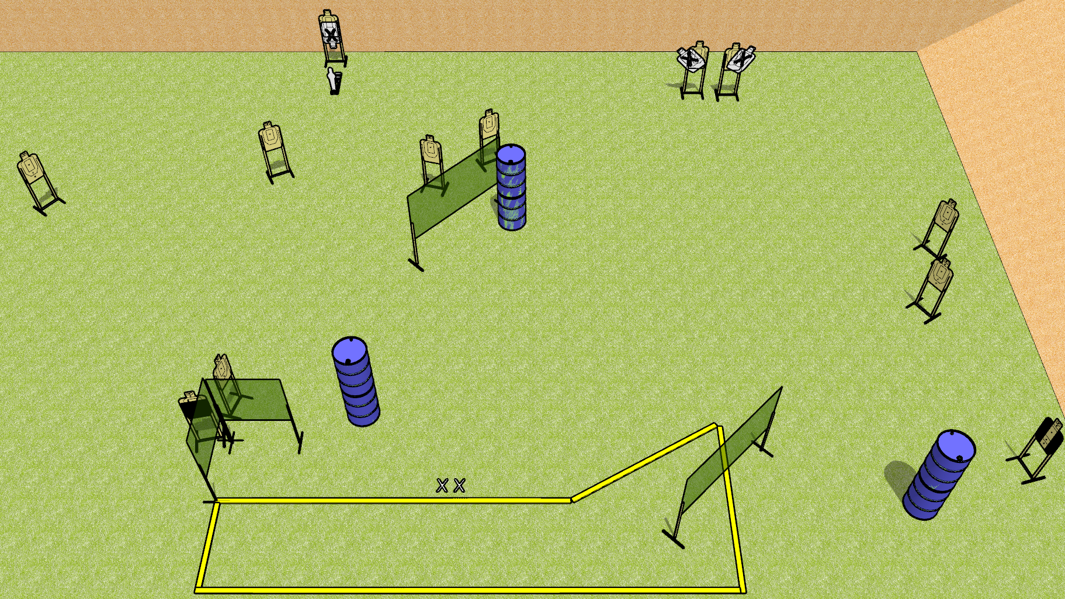
 | Dothan Gun Club – USPSA Match Danger Danger Course Designer : Drew Coleman
Round Count 25 rounds 12 USPSA targets 1 mini popper
Equipment List 7 wall feet 1 medium fault line 1 Tuxedo, one action target Notes: tuxedo on the right – position the barrels to force shooters up along the wall slightly

Slide 2
Danger Danger
Written Stage Briefing
Danger Danger is a 25 round, 125 point, Comstock course of fire. There are 12 USPSA targets and 1 mini popper. The best 2 hits on paper will score, and steel must fall to score. The start signal is audible.
Handgun start position is both feet on X’s, heels against fault line, wrists below belt. Handgun is loaded and holstered.
PCC start position is both feet on X’s, heels against fault line. Loaded carbine is held with both hands, stock on belt, safety on.
On start signal, engage targets as they become available from within the shooting area.

